Slide 1

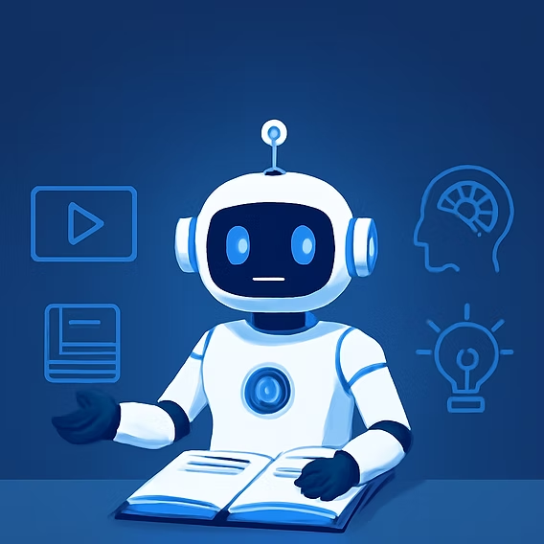
MULTI-AGENT SERVICE DESK FOR EDUCATION
By Opticloud2
REDUCING WAIT TIMES, CONCURRENCY AND BUILDING TRUST THROUGH SECURE AUTOMATION

Slide 2

AGENDA
3 | Problem and objective
4 | Wait-time metrics (humans vs automation)
5 | Architecture
6 | Design: concurrency and scalability
7 | Example concurrent flow
8 | How we build trust (security and transparency)
9 | Conclusions and next steps
10

Slide 3


PROBLEM
  Large universities receive thousands of repetitive requests: password resets, transcript requests, enrollment queries, scholarship questions, etc.
  This creates long wait times, a growing backlog, and high operating cost.
  Objective: Reduce wait and backlog by automating routine tasks and escalating complex cases to humans with traceability and control.

Slide 4


WAIT TIME: HUMANS VS OUR AUTOMATION
  Human (institutional / market average): First response time can range from hours to several hours depending on load and channel; market examples show dramatic reductions when using AI.
  Our automation (goal / prototype):
  Initial automatic response: < 1 minute (instant bot reply).
  Automatic resolution of routine tasks: < 15 minutes (depends on system integrations).
  Cases escalated to a human: average human resolution time 4–48 hours (depends on approvals and processes).
  Target self-resolution rate: 50–70% of routine inquiries handled automatically.

Slide 5
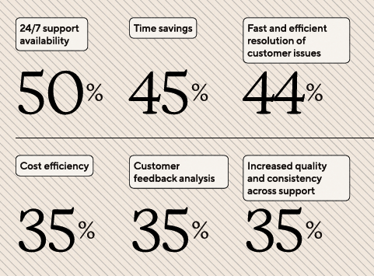
EVIDENCE: WHY BOTS IMPROVE OPERATIONS
The top benefits support teams see from using AI
  Studies and case reports show significant reductions in first response time and resolution time when chatbots/AI are used
  Practical examples: improvements from 6 hours to 70 minutes average response time after adopting AI in some processes.
  Measurable benefits: lower operating costs, increased capacity during peaks, improved CSAT.

Slide 6
ARCHITECTURE
RAG pipeline: Landing Data Lake → chunking → embeddings → Azure AI Search → traceable answers
Channels: Web chat, phone (Speech SDK + Azure Communication Services)
1
4
Coordinator / Orchestrator: Classifies, extracts entities, routes to the right agent
Secure execution: Runbooks on PSI / Azure VMs, credentials in Azure Key Vault.
2
5
Specialized agents: IT Support, Student Services, Administrative, VoiceRAG, Runbook Agents
Secure execution: logs to Application Insights / Azure Monitor
3
6

Slide 7
CONCURRENCY AND SCALABILITY
How we handle concurrency and why it’s scalable
Each agent runs in an individual container (pod/container) → can be scaled horizontally per agent based on demand.
The Coordinator consumes messages at a controlled rate; agents consume from their own queues / work queues and scale independently.
Azure Service Bus acts as a decoupling buffer: when thousands of tickets arrive simultaneously, messages queue and protect the Coordinator Agent from overload.
Idempotent architecture and transactional runbook design prevent adverse effects on retries.

Slide 8
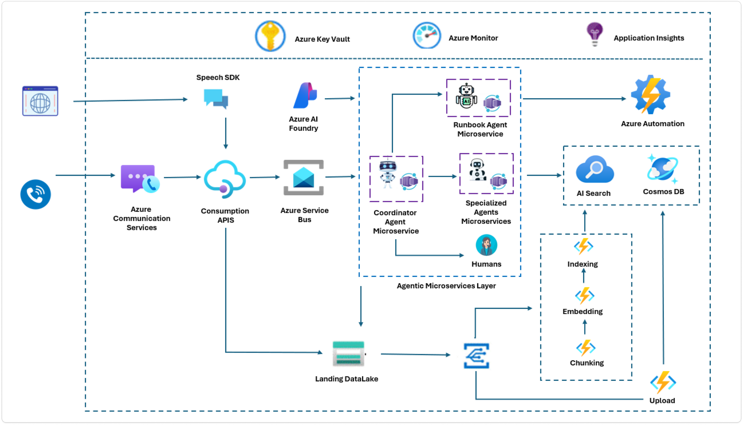
ARCHITECTURE

Slide 9

TRUST: SECURITY AND TRANSPARENCY
Credentials stored in Azure Key Vault (never in prompts).
Least privilege applied to execution accounts.
Runbooks with preconditions and gates (if not met → escalate to human).
Every action produces a natural-language explanation (what was done and why).

Slide 10
EXAMPLE CONCURRENT FLOW
1
2
3
4
5
Automatic responses and tickets are created. Only ~5% require human verification → re-routed to Administrative Agent / operator.
Messages enter the Service Bus topic.
Coordinator pulls messages at a steady rate and performs minimal identity validation.
IT Runbook Agent scales to execute concurrent resets using credentials stored in Key Vault.
2,000 “reset password” requests in 1 minute.

Slide 11
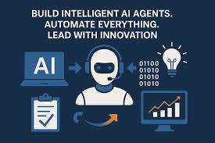
CONCLUSION & NEXT STEPS
  Reduce wait times and backlog: automate routine tasks + use RAG for reliable answers.
  Scalable, concurrent architecture with Service Bus and containers.
  Build trust through security, traceability and user explanations.
  Next steps: integrate with the real SIS, perform load testing, pilot with one faculty/unit.

